Slide 1




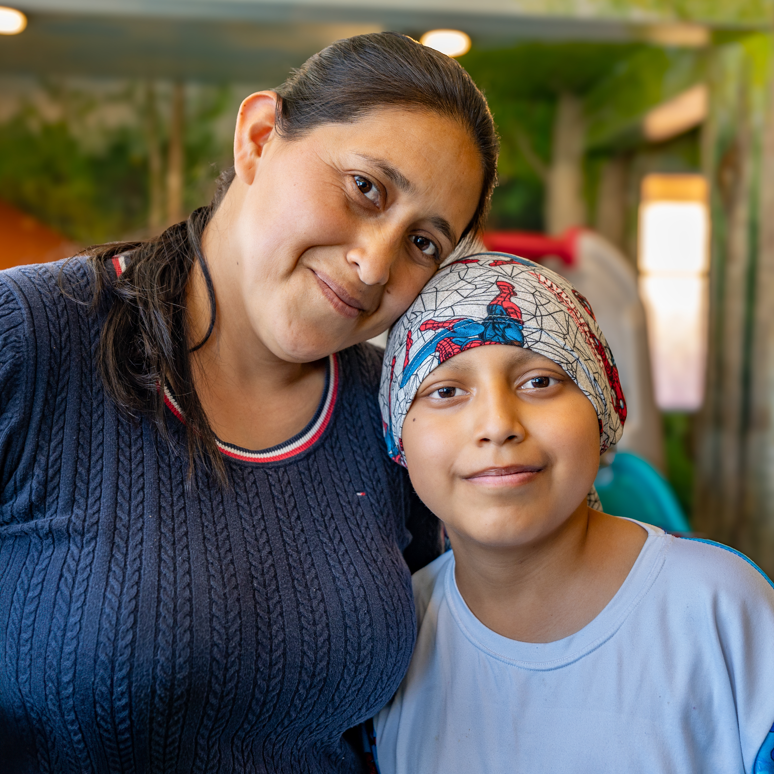
In collaboration with
Welcome to the Global Platform

Slide 2

GICC: Listening to countries’ needs
80%
1. Analysis of cancer health system
2. National Cancer Control Strategy Development/implementation
3. Implementation of cancer workforce training packages
GICC countries requested action on improving access to childhood cancer medicines
4. National network and referral pathway strengthening
5. Defining national standards and guidelines for index cancers
6. Essential medicines and technologies strengthening, including via UN
7. Economic analysis and benefit packages review of cancer
8. Strengthening & linking cancer registries (population & hospital based)
9. Country dashboard for childhood cancer monitoring
10. Local/regional advocacy portfolios: case studies, awareness campaigns

Slide 3

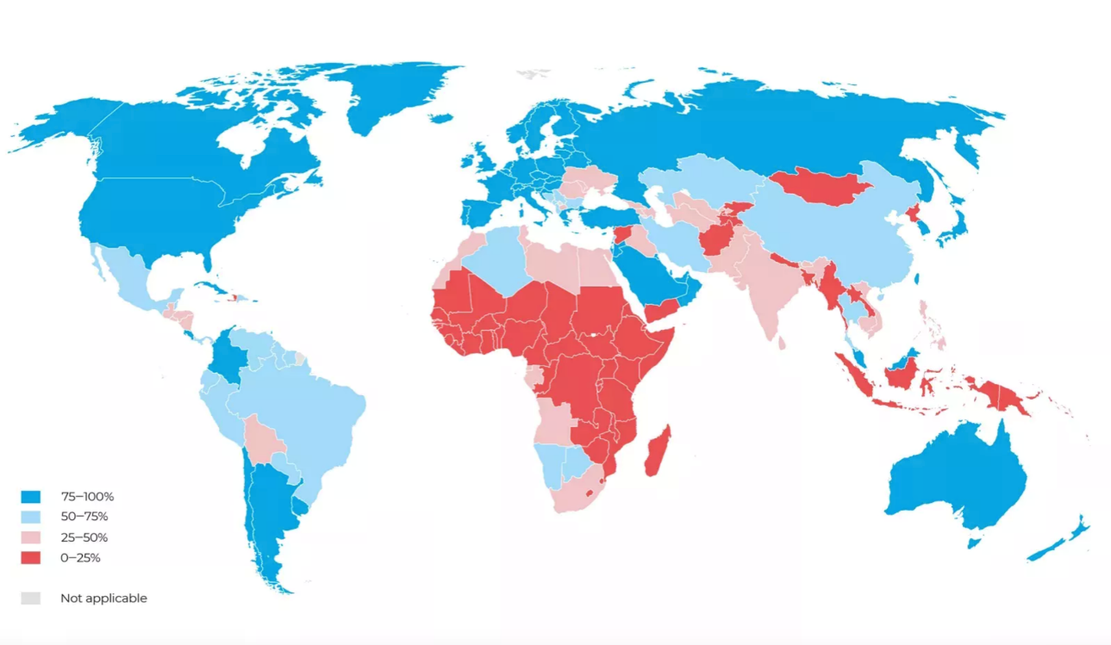


What are the challenges?
AVAILABILITY
QUALITY
COST

Slide 4



What does the Global Platform aim to achieve?
Purchase and distribute 58 formulations based on the EML for childhood cancer at no cost to recipient countries.
$
US$200 million from St. Jude
Uninterrupted supply of quality-assured, safe, effective medicines for
120 000 children
Products must be approved by a Stringent Regulatory Authority
Kasper / 4

Slide 5
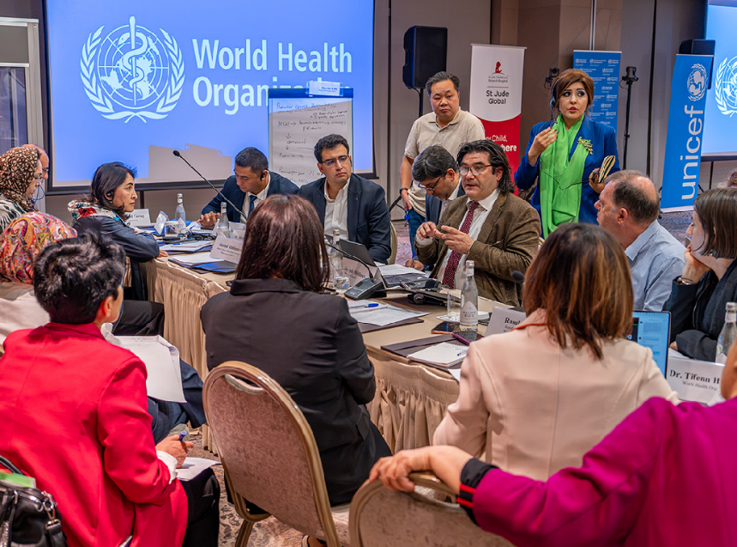




How does the Global Platform work?
St. Jude and WHO, in collaboration with, UNICEF and PAHO Strategic Fund work alongside governments and national stakeholders in a co-design process to procure, distribute and provide childhood cancer medicines. This connection with key national stakeholders and local technical experts across the lifecycle of engagement is integral to the Global Platform’s approach.
UZBEKISTAN

Slide 6



What will the Global Platform deliver?
Kasper / 6

Slide 7


What will the Global Platform deliver?
Reinforce political commitment for childhood cancer control and support governments to safeguard families of children living with cancer
Kasper / 7

Slide 8

What will the Global Platform deliver?
Provide support for:
Good governance
Procurement planning
Clinical and supply chain assessments
Technical and financial support
Robust M&E
Kasper / 8

Slide 9
What will the Global Platform deliver?
Take innovative approaches that will help address the fragmentation in childhood cancer medicines through market shaping and collaborative partnerships
Kasper / 9

Slide 10
Co-designing with 12 countries
MOLDOVA
UZBEKISTAN
MONGOLIA
JORDAN
NEPAL
PAKISTAN
EL SALVADOR
SENEGAL
GHANA
SRI LANKA
ECUADOR
ZAMBIA
2024
2025

Slide 11


The long view: phases of country engagement
Systems Readiness
Active Receipt
Sustained Supply
Participating countries are encouraged to view their engagement with the Platform as a sustained partnership, the nature of which will change over time.
For most countries, the readiness phase spans Year 1 of engagement.
Encompasses priority actions to safely receive, transport, store and administer medicines.
Most countries begin to receive medicines in Year 2 of engagement.
Countries receive regular shipments of medicines and monitor and report quarterly.
Eventually, countries access medicines through a sustained supply mechanism co-designed with the Global Platform.

Slide 12
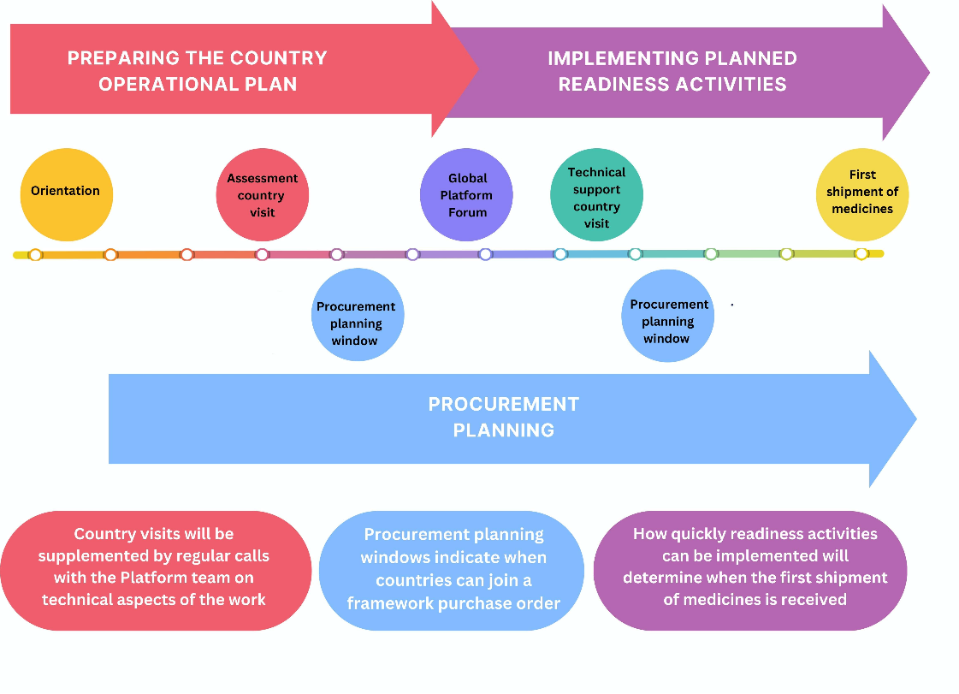
Systems Readiness – getting ready to receive medicines
Countries are assessed against minimum standards and a plan is developed and implemented to address un-met minimum standards.
In tandem, forecasting and quantification work feeds into procurement planning.
For most countries systems readiness spans Year 1 of engagement with the Global Platform

Slide 13
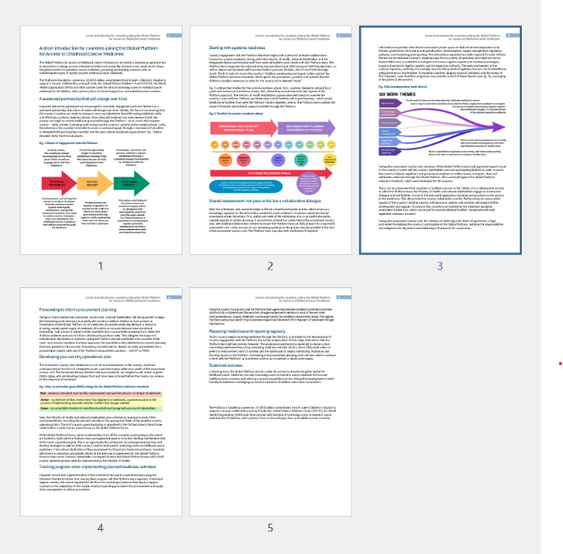
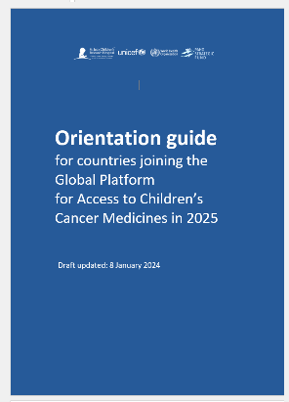
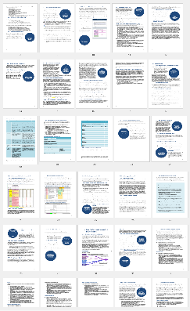
What you will receive from the Global Platform in February
A cohesive suite of documents and tools has been developed to support countries that we will start to introduce in turn at the appropriate point in the process
This includes some more information on the process
A short introduction
The Orientation Guide for countries joining the Platform in 2025
The short introduction is brief and provides an overview of the process.
The steps are described in more detail in the Orientation guide including information about financial and technical support available through the Global Platform.

Slide 14
What you can expect as the immediate next steps
In the coming weeks, the focus is on gathering and sharing information with an emphasis on key milestones for Q1 2025:
Focal
Points
A welcome survey will be shared that requests the names of the key people the Global Platform will be working with at the Ministry of Health and the National Regulatory Authority
Governance
Guidance will be provided on establishing a country governance mechanism for Global Platform activities
Facility Selection
Eligibility criteria for facilities will be shared to guide selection of participating facilities in the country
Letter of Agreement
A template ‘Letter of Agreement’ will be provided that is the agreement that is signed by the Minister of Health to formalize the country’s involvement with the Global Platform.

Slide 15







Proposed Platform Progress and Milestones 2025: Moldova
Feb 2025
Welcome & Orientation
Facility Selection
Governance
Letter of Agreement
Jun 2025:
Submission of Cost Estimate
Q3 2025:
Technical Support Visit
Q4 2025:
First shipment of medicines
March 2025:
Assessment Visit
Jul 2025:
Global Platform Forum
Q4 2025:
Completion of Readiness Activities

Slide 16




Conclusion: a transformational moment
Unique opportunity to build on GICC, ensuring medicines delivered in systems and facilities providing comprehensive quality care for children with cancer
The Global Platform is not just a donation program. It’s a partnership with countries as they work to solve persistent challenges to childhood cancer medicines’ access through a holistic approach, addressing end-to-end challenges
  Collaborate with key national stakeholders to understand each countries’ unique challenges
  Identify and address barriers to safe handling and storage of chemotherapy
  Apply system-based solutions to strengthening the supply chain
Connect countries and regions to exchange knowledge and share experiences to create synergistic change and maximize impact for children and their families

Slide 17
Thank you
LINKS
Global Platform website (WHO)
Global Platform website (St. Jude)
CONTACT
gpaccm@who.int
gpaccm@stjude.org

